Slide 1
Transcranial Magnetic Stimulation
TMS
A non-invasive tool for assessing corticospinal conduction and integration for motor control in humans
Notes:
Other than clinical examination, no evoked-event methods have been standardized for the purpose of assessing the functional condition of descending long tracts of the spinal cord in humans.

Slide 2
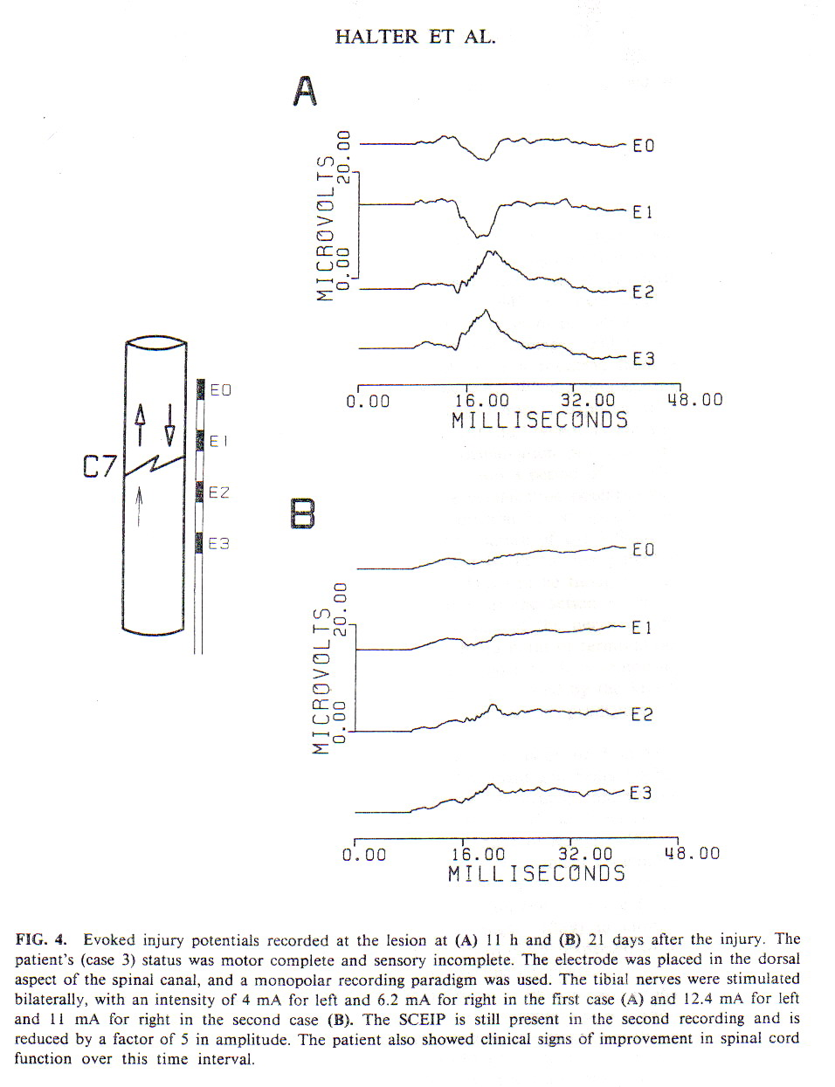
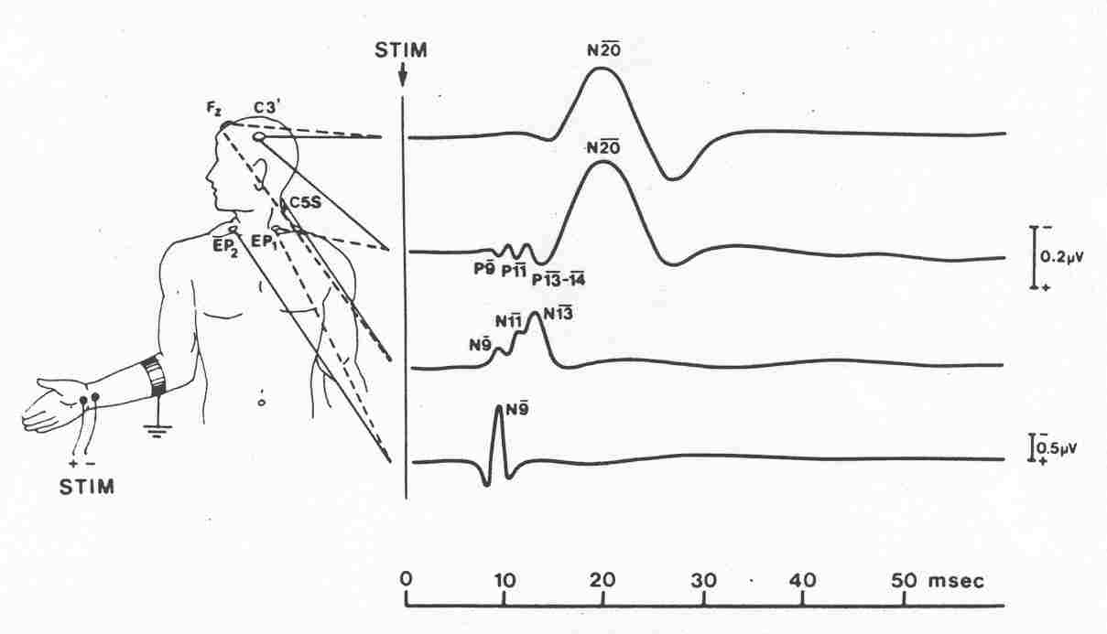
Notes:
Ascending system function has been evaluated through the use of somatosensory evoked potentials (SEPs) for nearly 30 years with recordings from the scalp (Grundy and Friedman, 1987; Chen et al., 1990), skin overlying the spine (Dimitrijevic et al., 1978; Sherwood, 1981), and the epidural space (Dimitrijevic and Halter, 1995).

Slide 3
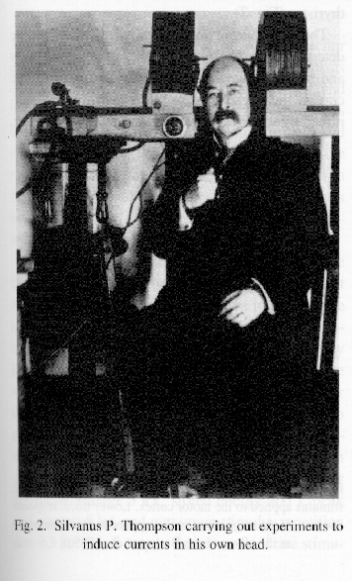
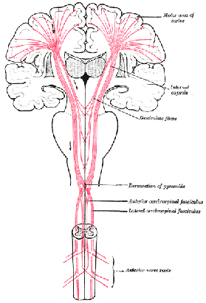

Slide 4
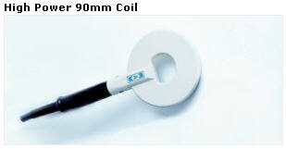
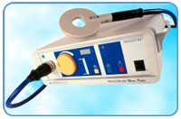
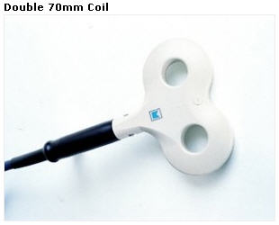
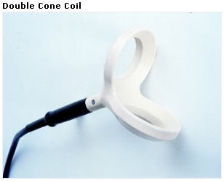
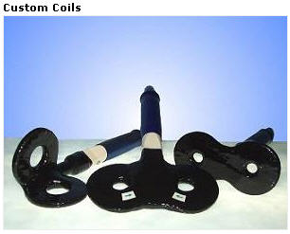
Magstim coils

Slide 5
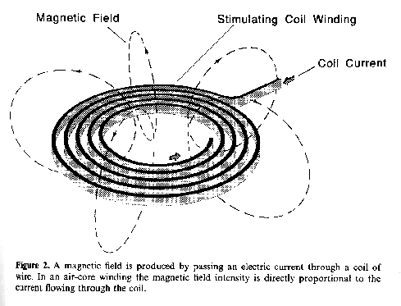
How Transcranial Magnetic Stimulation Works
Baker, AT, 1999, EEG Clin Neurophysiol, supp 51: 3-22
Current induced with respect to the “Right Hand Rule”

Slide 6
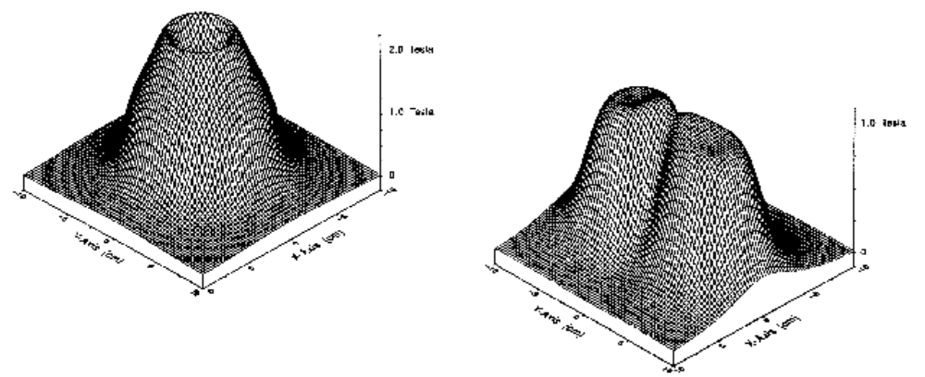
Magnetic Coil Characteristics
Jalinous, R, 1992, In:Clincal Applications of Transcranial Magnetic Stimulation, M. Lissens (ed), Peeters Press, Leuven
Field intensity directly proportional to current flow through the coil
Single Coil
Dual Coil

Slide 7
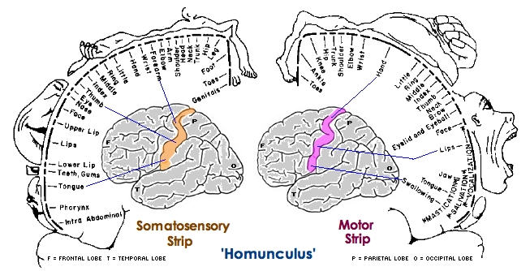
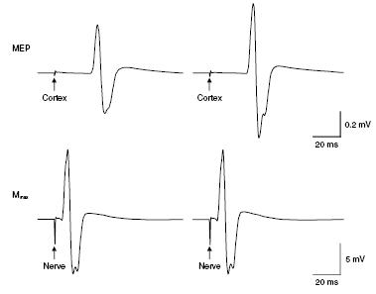
Transcranial Magnetic Stimulation of the Motor Cortex
Most efforts exploring motor cortex physiology have been focused on hand muscle representations
Notes:
Most efforts have been focused on hand muscle representations due to the relatively superficial, large, and accessible region of the neocortex. Lower limb representations require larger stimulus intensities.

Slide 8
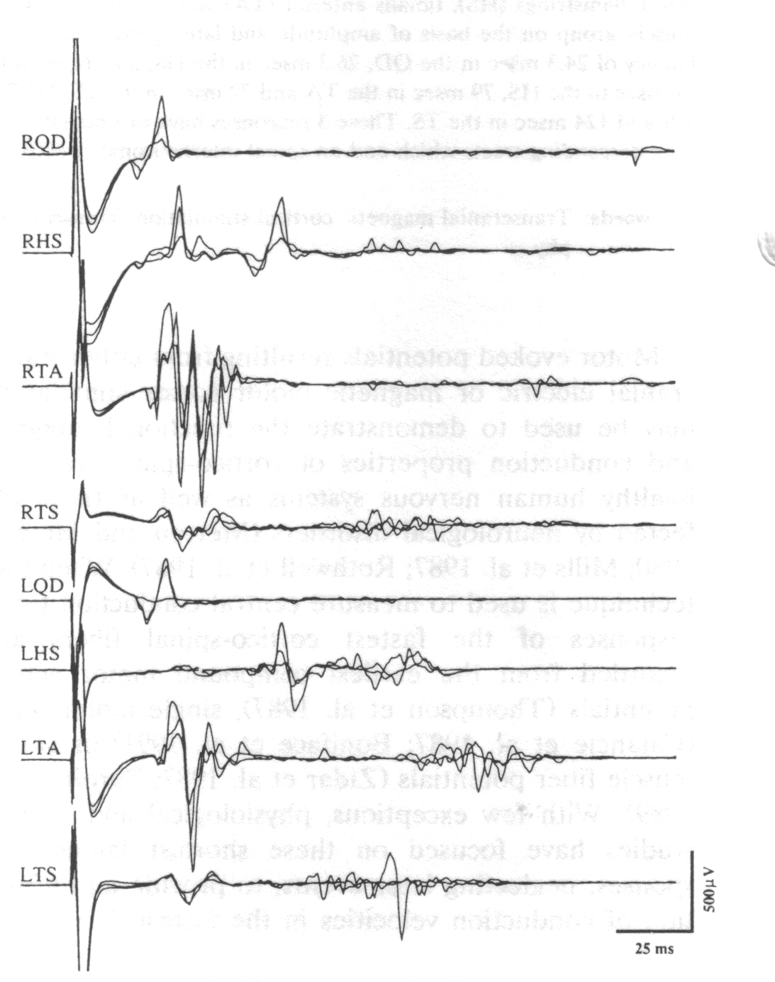
Transcranial Magnetic Stimulation of the Motor Cortex
Lower-limb muscle representations can be activated to produce MEPs
Notes:
Most efforts have been focused on hand muscle representations due to the relatively superficial, large, and accessible region of the neocortex. Lower limb representations require larger stimulus intensities.

Slide 10
What has been learned about the behavior or physiology of the motor cortex using TMS?
Low stimulus rates are safe, not likely to induce seizure, and TMS can break Status Epilepticus (continuous seizure)
Voluntary activation or even intention to activate enhances the responsiveness of the neocortex , lowers the threshold and increases the amplitude of the motor evoked potential (MEP)
Fatiguing voluntary contractions bring a reduction of MEP amplitude that lasts up to 30 seconds
Deafferentation brings loss of MEP in the deafferented muscles and an increase in MEP amplitude in those bordering the deafferentation

Slide 11
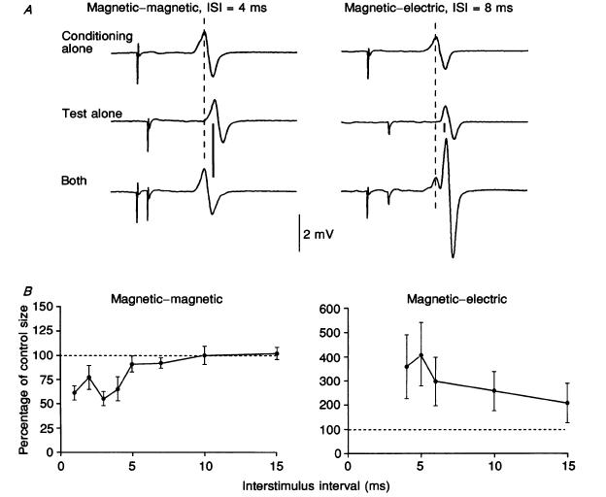
Paired-pulse TMS was used to demonstrate the presence of intracortical inhibitory circuitry (first dorsal interoscious muscle)
Kujirai T, Caramia MD, Rothwell JC, Day BL, Thompson PD, Ferberts A, Wroe S, Asselman P, Marsden CD. Corticocortical Inhibition in Human Motor Cortex. J Physiol (Lond) 1993 471:501-519.
Notes:
The group from the Instituteof Neurology in Queen’s Square, London have produced much of the basic physiological knowledge regarding transcranial magnetic motor cortex stimulation. Papers by the authors listed on this article can be found in the reference lists of most TMS-based published papers. Kujirai T, Caramia MD, Rothwell JC, Day BL, Thompson PD, Ferberts A, Wroe S, Asselman P, Marsden CD. Corticocortical Inhibition in Human Motor Cortex. J Physiol (Lond) 1993 471:501-519.
Another group of basic human neuroscientists who have published much on TMS are from NIH under the direction of Dr. Mark Hallet whose name appears as the last author on their papers.

Slide 12
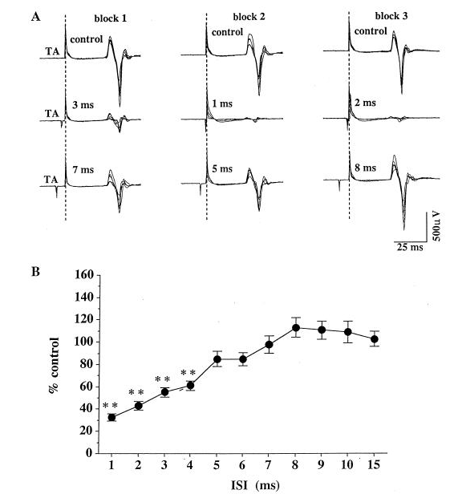
Intracortical inhibition was shown to be present with very similar characteristics for TMS induced MEPs in lower-limb muscles and was not changed by fatiguing muscle contractions
Stokic DS, McKay WB, Scott L, Sherwood AM, Dimitrijevic MR. Intracortical inhibition of lower limb motor-evoked potentials after paired transcranial magnetic stimulation. Exp Brain Res 1997 117:437-443.

Slide 13
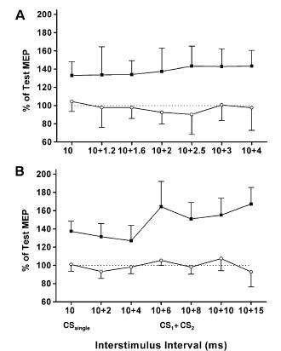
TMS-induced MEPs (FDI) are augmented with ISI above 10 ms
Bestmann S, Siebner HR, Modugno N, Amassian VE, Rothwell JC. Inhibitory interactions between pairs of subthreshold conditioning stimuli in the human motor cortex. Clin Neurophysiol 2004115:755–764.
Notes:
Fig. 5. Effect of single and double conditioning pulses at facilitatory ISIs. Paired pulse TMS was applied at an ISI of 10 ms. Responses are shown for conditioning pulses which were non-effective (open circle) and effective (filled box) to induce ICF. (A) group mean + SD responses for CS1-CS2 intervals of 1.2, 1.6, 2, 2.5, 3, and 4 ms, respectively. (B) group mean + SD responses for CS1-CS2 intervals 2, 4, 6, 8, 10, and 15 ms, respectively. No facilitatory or inhibitory interaction was revealed at short CS1-CS2 intervals (P . 0:5). When a CS single evoked ICF at an ISI of 10 ms, additional ICF was observed at longer CS1-CS2 intervals, which was not significant (P . 0:3).

Slide 14
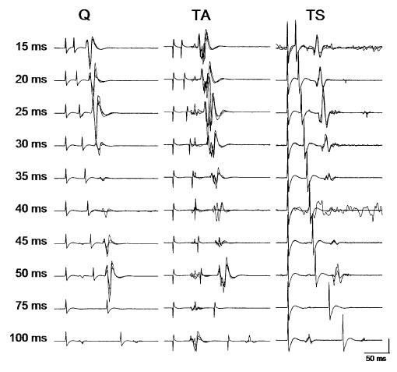
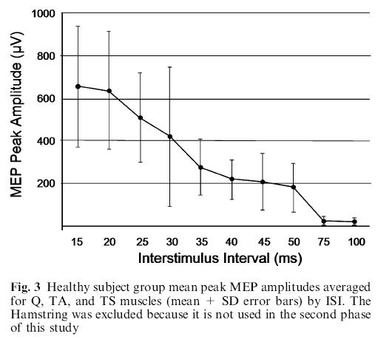
Longer interstimulus intervals bring augmentation of lower-limb MEPs (TMS was subthreshold for single pulse)
McKay WB, Lee DC, Lim HK, Holmes SA, Sherwood AM. Neurophysiological examination of the corticospinal system and voluntary motor control in motor-incomplete human spinal cord injury. Exp Brain Res 2005 163: 379–387.

Slide 15
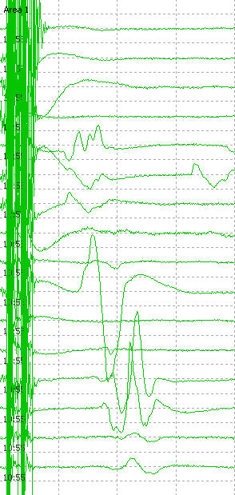
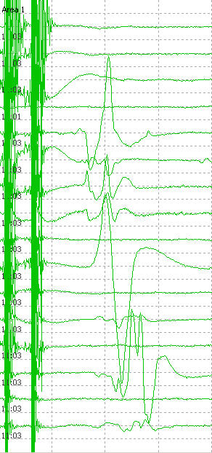
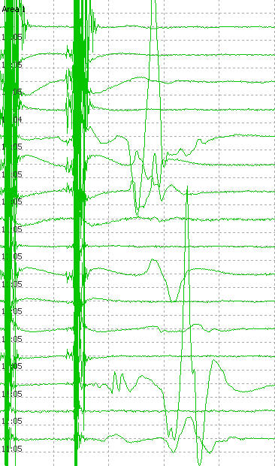
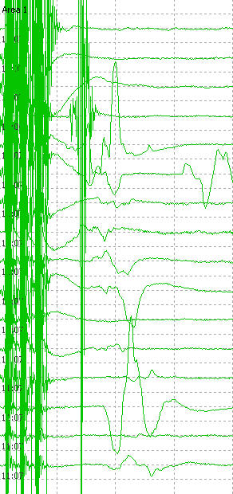

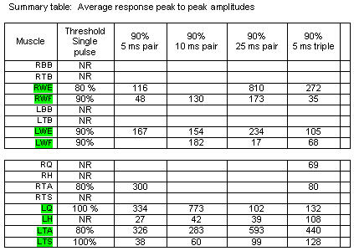

Slide 16
Use of TMS-induced MEPs in ACUTE Spinal Cord Injury
Presence or absence – patency of the fast-conducting corticospinal system
Can be used in unconscious patients
Central Motor Conduction Time (CMCT) – conduction qualities such as slowing induced by demyelinating processes
Useful as a monitor of corticospinal system conduction during surgury
Quality of motor control
Presence early after injury may suggest good recovery
Use of TMS-induced MEPs in CHRONIC Spinal Cord Injury

Slide 17
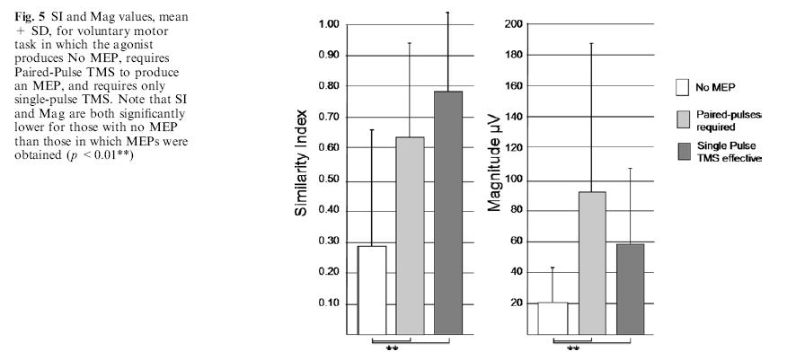
TMS-induced MEP thresholds are related to the quality of motor control in motor-incomplete SCI subjects
McKay WB, Lee DC, Lim HK, Holmes SA, Sherwood AM. Neurophysiological examination of the corticospinal system and voluntary motor control in motor-incomplete human spinal cord injury. Exp Brain Res 2005 163: 379–387.

